Slide 1
Deep Medicine
Authored by Eric Topol
Presented by Cory davis

Slide 2
Contents
Chapter 1: Introduction to Deep Medicine
Chapter 2: Shallow Medicine
Chapter 3: Medical Diagnosis
Chapter 4: The Skinny on Deep Learning
Chapter 5: Deep Liabilities
Chapter 6: Doctors and Patterns
Chapter 7: Clinicians Without Patterns
Chapter 8: Mental Health
Chapter 9: AI and Health Systems
Chapter 10: Deep Discovery
Chapter 11: Deep Diet
Chapter 12: The Virtual Medical Assistant
Chapter 13: Deep Empathy

Slide 3
Chapter 1: Introduction to Deep Medicine
3 D’s of Medicine
Deep Phenotyping
“deeply define each individual, using all relevant data”
“thick and long”
Deep Learning
Using AI and ML to determine diagnosis and treatments
Deep Empathy and Connection
Bringing back personal “care”
Time spent between Doctors/Patients is at an all time low

Slide 4
Chapter 1: Introduction to Deep Medicine
Deep Phenotyping
Newborn boy went home after the third day
Was brought back as he was having constant seizures
CT scan normal, ECG only showed seizures
Drugs failed to stop seizures
Blood sample sent for rapid whole-genome sequencing
AI processed the medical record
ML algorithm determined 962 of 5 million genetic variants
Combining these led to discovering a variant that was in less than 0.01% of the population
The Boy was given vitamin B6 and arginine, and almost immediately the seizures ended

Slide 5
Chapter 1: Introduction to Deep Medicine
Doctors are too busy with too many patients
Not enough time to form a working relationship with a patient
Topol was told by his orthopedist he should be prescribed anti-depressants
Bad knees led to surgery, extremely painful rehab, lack of sleep, and crying spells
Meds would “help” symptoms but not cause
Not until he told his doctor about Arthrofibrosis did the doctor consider he had it.

Slide 6
Chapter 2: Shallow Medicine
Emotional breakdown (superficial contact) between patient and doctor
Can lead to mistaken or excessive diagnosis
Leading to unnecessary or incorrect tests or treatments
30-50% of 80million/year CT scans are unnecessary
American Board of Internal Medicine Foundation (ABIMF) – Choosing Wisely initiative, goal to reduce unnecessary tests
Proved to show little if any results

Slide 7
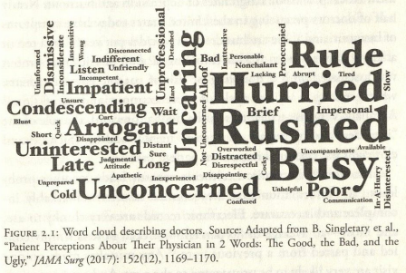
Chapter 2: Shallow Medicine

Slide 8
Chapter 2: Shallow Medicine
Primary factors for failure
“physicians overestimate the benefits of what they do”
“the lack of any mechanism to affect change in physicians’ behavior”
No “patient-driven demand for better, smarter testing.”
Shallow Evidence
Inadequate data from exams or medical literature leads to shallow medical practice
American heart Association and American College of Cardiology changed the definition of high blood pressure
Led to 30 million more Americans diagnosed with hypertension
This was done “despite the lack of any solid evidence to back up this guideline”

Slide 9
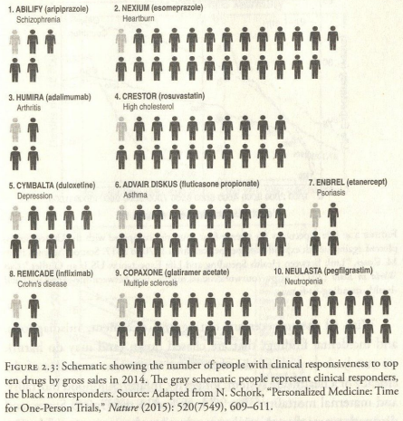
Chapter 2: Shallow Medicine

Slide 10
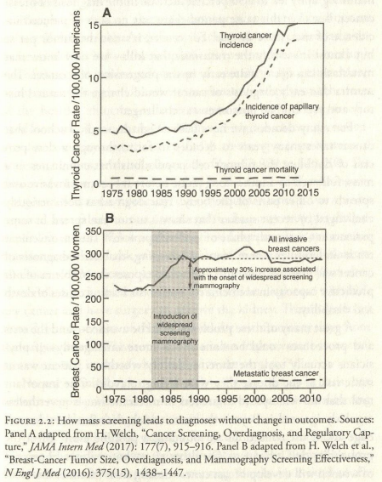
Chapter 2: Shallow Medicine

Slide 11
Chapter 3: Medical Diagnosis
System 1 thinking
Automatic, quick, intuitive, effortless
Uses heuristics, or rules of thumb
System 2 thinking
Slow, reflective process involving analytic effort
Accuracy of diagnosis in under 5 min: 98%
Accuracy of diagnosis after 5 min: 25%
12 million serious diagnostic errors each year in the US

Slide 12
Chapter 3: Medical Diagnosis
Potential Cognitive Biases
10,000 human diseases
Doctors cannot know that many, and will miss diagnosis based upon with what they are familiar
“80 percent of doctors don’t think probabilities apply to their patients”
Largest cause of malpractice cases (31%) come because a doctor was delayed or did not consider a diagnosis to be viable
No mechanism for providing doctors with feedback on their accuracy
Many attempts to crowd source diagnosis via phone apps
One yielded 84% accuracy, but author is not encouraged by that
IBM Watson was a failure in improving diagnoses

Slide 13
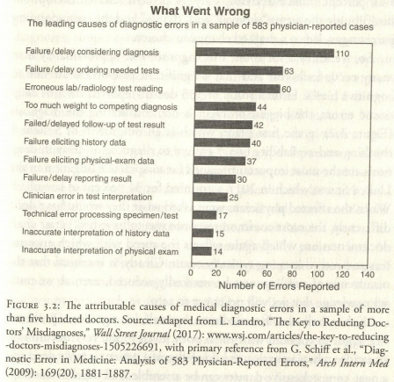
Chapter 3: Medical Diagnosis

Slide 14
Chapter 4: The Skinny on Deep Learning
AliveCor wanted to predict potassium levels via ECG on an AppleWatch
Initial tests failed
Receiver Operating Characteristic (ROC) curve measured 0.63 (very poor)
After altering analysis
ROC measured 0.86 (very good)
Lesson learned
Don’t filter data too early in training

Slide 15
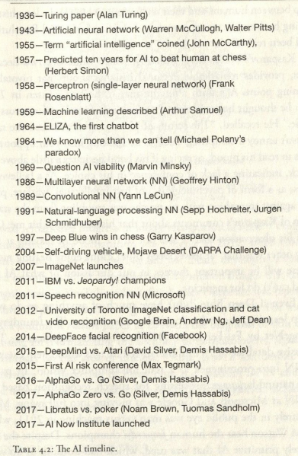

Slide 16
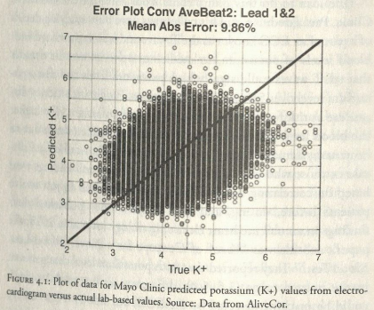
Chapter 4: The Skinny on Deep Learning

Slide 17
Chapter 4: The Skinny on Deep Learning
Brief history of Deep Learning
Deep Neural Networks
Enormous data sets
Dedicated GPUs
Cloud Computing
Open-source algorithmic development modules
Regarded as a general-purpose technology
Applied largely to games, images, voice and speech, and driverless cars

Slide 18
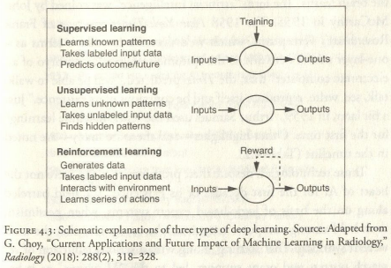
Chapter 4: The Skinny on Deep Learning

Slide 19
Chapter 4: The Skinny on Deep Learning
Games
AI won Othello, Checkers, Scrabble
1997 Deep Blue beats Garry Kasparov in Chess
Rule based AI
2015 – Deep Mind beat Atari’s Breakout
2016 – AlphaGo beats world champion Lee Sodol in Go
30 million training games
2017 – AlphaGoZero
No real training games
Played 5 million games against itself
2017 – Libratus algorithms beating professional poker players

Slide 20
Chapter 4: The Skinny on Deep Learning
Images
Helped with introduction of open source Big Data images
Reduced error rate to better than human performance in 2016
Below 4% error rate in 2017
Apple’s Face ID
2014 researchers found AI to be more accurate at determine emotion than humans
Imaging not confined to face
AliveCor DNN uses ECG data to identify people

Slide 21
Chapter 4: The Skinny on Deep Learning
Voice, Speech, Text Recognition, and Translation
2017 – Microsoft AI transcribes speech better than humans
This recognition enables Alexa and other digital assistants

Slide 22
Chapter 4: The Skinny on Deep Learning
Driverless Cars
Society of Automotive Engineers (SAE) 5 levels of autonomy
Medicine will not reach Level 5
Level 3 is achievable
The AI for self driving uses DNN
Identifying pedestrian error rate
1 out of 30 frames
1 out of 30 million frames

Slide 23
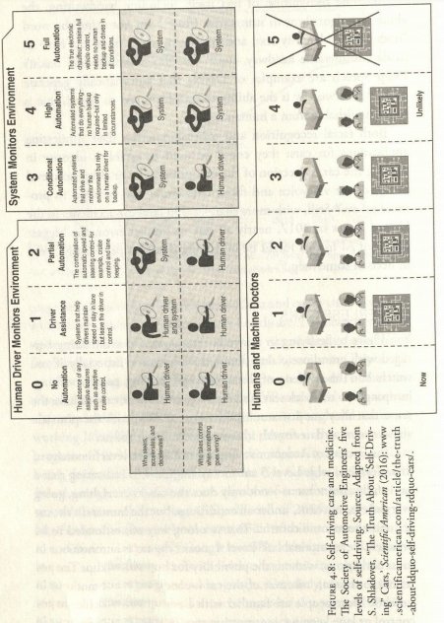
Chapter 4: The Skinny on Deep Learning

Slide 24
Chapter 5: Deep Liabilities
NN Limits
Good at narrow specific tasks
Cannot compete at “general intel and common sense of a toddler”
Too often people believe AI “thinks” like a human
Black Boxes
The models are built, but how they work is unknown
Certain fields (medicine) shouldn’t rely on black box AI
AI is being used to determine how AI works
EU General Data Protection Regulation (2018)
Explanations must be given for decisions from automated systems

Slide 25
Chapter 5: Deep Liabilities
Bias and Inequities
AI is learning racial, gender, economic, orientation bias
The programmers must learn how to prevent this
The Blurring of Truth
AI can create and perpetuate fake images, videos, and audio
Facebook – Cambridge Analytica
Privacy & Hacking
Facial data is everywhere now, 50% of adults have their face in police accessible database
Medical data could potentially be used for advertisements
Google owns Deep Mind
AI vs AI

Slide 26
Chapter 5: Deep Liabilities
Ethics and Public Policy
Should AI progress be slowed down
Driverless car “3 choice” dilemma with no “right” answer
Does AI require an ethics board?
Jobs
AI changes how people work
Projected 19 million jobs lost but 21 million new jobs created in the next 15 years
What to do about this transition

Slide 27
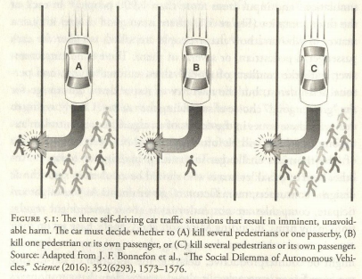
Chapter 5: Deep Liabilities

Slide 28
Chapter 5: Deep Liabilities
Existential Threat
Could AI destroy humans?
Terminator, Ex Machina, 2001: A Space Odyssey, The Matrix
Stephen Hawking, Elon Musk, Henry Kissinger, and Bill Gates say yes
Alan Bundy, Mark Zuckerberg say no
Musk and Sam Altman founded Open AI to work for safer AI
Today’s AI is very narrow and not close to destroying humans
Issue isn’t will life become extinct but how will AI change it

Slide 29
Chapter 6: Doctors and Patterns
Currently radiologists that read X-rays or CT scans don’t see patients
Only send reports on the image
Deep Learning can be used to read these scans
This would allow the radiologists to have 1on1 time with patients to discuss the scan
Radiologists rely on System I reflex thinking
This can sometimes lead to “inattentional blindness”
Superimposed picture of a man in a gorilla suit, with 83% of radiologists missing it
31% of radiologists experience a malpractice claim
False positives: 2%
False negatives: 25+%

Slide 30
Chapter 6: Doctors and Patterns
While Deep Learning can analyze the images, radiologists can provide a holistic assessment that the machines cannot do.
DL is good for a narrow or very specific function, but it is not nearly ready to fully take over for a radiologist
It will help a radiologist with the job, and could allow them to discuss the test with the patient, or advice patients away from unnecessary testing
Pathologists are using similar DL to make more accurate tests for lung cancers.
While test accuracy has gone up, false positives are still higher than humans
In Dermatology, IBM Watson and CNNs performed as good or better than dermatologists

Slide 31
Chapter 7: Clinicians Without Patterns
AI can help with Electronic Health Records (EHR)
Transcribe speech
ML can synthesize the notes into proper formatting
Eye Doctors
Retinal imaging for diabetes patients
Identifying cases of Diabetic Retinopathy
#1 global cause of vision loss
Google’s CNN
Sensitivity of 87 to 90 percent
Specificity of 98 percent
IBM’s CNN
Accuracy of 86 percent
Track and predict age-related macular degeneration (AMD), diabetic retinopathy, glaucoma, cataracts, and Alzheimer's

Slide 32
Chapter 7: Clinicians Without Patterns
Heart Doctors
Reading ECG and echocardiography (echo)
ECG algorithms assessed in 1991 yielded accuracy of 69% (poor), same algorithms are still routinely used today
ECG AI is relatively young and unreliable
Rule based AI
Recent development DNN to diagnose heart attacks
Sensitivity 93%
Specificity 90%
34-layer CNN by Stanford
Outperformed 6 cardiologists for most arrhythmia categories
Aggregate positive predictive values between 70-80%
ECG with Apple Watch
Record activity in real word environments

Slide 33
Chapter 7: Clinicians Without Patterns
Cancer Doctors
AI sequencing native DNA, tumor DNA, and tumor RNA
IBM Watson
Yielded “hyperbolic results”
Did not represent cognitive computing
Matched patient mutation with clinical trials
No hidden layers used, no deep learning took place
Tempus Labs
Started in 2015 by the founder of Groupon
Aim to fix the data infrastructure in cancer
Now collaborate with 40 Nation Cancer Institute centers
Range of research
From sequencing to culturing

Slide 34
Chapter 7: Clinicians Without Patterns
Surgeons
AI does not have much presence in surgery
Robots are being used in some surgeries
Currently used in less than 10 percent of worldwide surgeries
Can put in a row of sutures without human assistance
Surgery can be performed remotely with robots
Other Healthcare Professionals
Eventually AI could take over all clinician roles (possibly hundred years out)
Nurses however will be spared
AI could help nurses with their jobs
AI cannot replace the human touch

Slide 35
Chapter 8: Mental Health
People are more comfortable talking to a machine than a real person
Instagram study
Machine detection accuracy of 70% for diagnosing depression
Depression
350 million people globally have depression
Makes up 10% of the global burden of disease
7% of Americans are diagnosed with it each year
Measuring brain waves are suggested as a way to diagnose mental health problems
ML attempting to predict a patient’s response to various medications only yielded about 60% accuracy

Slide 36
Chapter 8: Mental Health
Increasing suicide rate in the US
120 per day in 2017
More than homicide, AIDS, car accidents, and war
Unsupervised learning algorithm (Vanderbilt and Florida State)
Accurately predicted suicide attempts nearly 80% of the time
Logistic regression of traditional risk factors only accurate 60% of the time
Cincinnati Children’s Hospital developed a ML algorithm
93% accuracy for predicting “serious risk of suicide”
Incorporated data from real-world interactions (laughter, sighing, anger)
Chatbots are becoming more prevalent
People are more likely to talk to a machine
Not enough mental health professionals
AI can help bridge that gap

Slide 37
Chapter 9: AI and Health Systems
End of life is hard to predict
Father In Law was a fully healthy 90 year old, suddenly had end-stage liver disease
80% of people would prefer to die at home
However only 40% are able to die at home
18 layer DNN
Used extra data such as, number of spinal or urinary system scans
These were just “as statistically powerful as the person’s age”
90% of those predicted to die between 3-12 months did
Same results for predicting people to live more than 12 months
Predicting readmittance to hospital another key element

Slide 38
Chapter 9: AI and Health Systems
Healthcare Workforce and Workflow
More workers are costing more money
Many tasks are done better by AI
Record keeping
Recommending cures
Automating medical imaging
Prediction hospital born infections
Machine vision (infrared light)
Used to determine how clean a worker’s hands are
This can lead to reduction in hospital infections
Also use to determine patient risk of pulling out breathing tube

Slide 39
Chapter 10: Deep Discovery
Cancer Genome Atlas of biologic data, holds 2.5 petabytes of data from 30,000 patients
Using AI tools to decode genomes
Deep Sequence and Deep Variat tools being used to understand effect of genetic mutations on the human body
Applications in Cancer as it is a genomic disease
Drug Discovery and Development.
Clinical trials are slow and sometimes inaccurate
Atomwise uses deep learning to screen millions of molecules to help in drug discovery. Allows for quicker identification of compounds that could potentially cure a disease.

Slide 40
Chapter 10: Deep Discovery
Acceleration Therapeutics for Opportunities in Medicine (ATOM)
Brings academics and pharmaceutical companies together to research possibilities and bring those results to the drug development community
ATOM seeks to reduce the length of time necessary to go from identifying a working drug to developing the drug.
Normally taking 4 years, using deep learning ATOM believes that can be reduced to 1 year
Beyond development, dosage is being targeted for AI as well
Proper dosage includes age, gender, weight, genetics, and many other factors
This makes machine learning perfect to determine accurate drug doses
In Neuroscience, AI is being used to understand how the brain works
Lessons learned from this are being used to design more efficient computers

Slide 41
Chapter 11: Deep Diet
Science of Diet is messy
Studies are difficult because proper data comes from potential years of tracking a strict diet regime
Over the last 100 years various foods have been labeled “bad” without real data to support those claims
More than 1000 Americans die per day as a result of a poor diet
This includes complications from diabetes, obesity, clogged arteries, etc.
The field of nutrigenomics is using deep learning to study how various foods interact with an individual's DNA.
Glucose levels, cholesterol levels, salt levels, etc.
This could lead to more specific and better meal planning

Slide 42
Chapter 12: Virtual Medical Assistant
Progression from Siri to Cortana to Google Assistant
AI devices can be the next “tech unicorn” that permanently changes our lives
Amazon’s Alexa makes up 70% of AI devices
AI speech recognition is faster than typing
Not yet to the point where Alexa can truly converse with a person
VMA’s voice assist
Help visually impaired, currently 250 million people in the world
Voice apps can turn speech into text, and text to speech
This could help the 780 million adults (worldwide) that cannot read or write

Slide 43
Chapter 12: Virtual Medical Assistant
Apps are being designed to monitor and guide patients
Guides users to reverses Type 2 diabetes
Migraine Alert – predicts migraines with 85% accuracy
ResApp Health – monitors breathing to diagnose potential lung conditions
VMAs of the Future
Will make gathering medical history easier: beginning with pre-natal history
Gathers the data as unobtrusively as possible
However it needs quality data to make accurate decisions
“Bottleneck” will be the ability to gather patient data in one place
But the assistant will coach the user to a “self-driving healthy” lifestyle

Slide 44
Chapter 13: Deep Empathy
Doctors visits have become less personal
1 hour for a first-time visit is now 12 minutes
30 minutes for a return visit is now 7 minutes
The Gift of Time
Time for the doctor/patient relationship is essential to the patient’s quality of care, but also the doctor’s quality of life
Every minute spent with the patient, risk of readmission reduces
Reduces hospitalization by 20%, will save millions of dollars
Being Human
AI cannot show true sympathy or recreate the human touch
The human connection makes patients feel cared for
Positive relation between doctor’s empathy and patient outcomes
Empathy can be taught/learned over time

Slide 45
Chapter 13: Deep Empathy
Presence
Doctors on average interrupt a patient in the first 18 seconds
Let the patient share their story, and truly listen to it
The ability to listen and observe begins the foundation of trust
The Physical Exam
Scans and other tests may yield better information
This continues the trust building with a patient
It’s part of the “human connection”
Author did not perform a physical exam, instead a different doctor did
His patient was not happy, because the doctor he trusted did not perform the exam

Slide 46
Chapter 13: Deep Empathy
Medical Education
Perhaps needs a major update in how students are selected and taught
Students are selected based on knowledge of science
No selection tests for humanistic qualities
Education should be rewired to human oriented rather than disease oriented
Most educational settings do not teach future doctors to be humanistic
Deep Medicine
In the early days of AI medicine
Narrow AI will take hold as the ML algorithms become more accurate in practical settings
Many healthcare jobs can be optimized using AI tools
This can allow doctors to care for the patients rather than the computers on which the enter data

